Slide 1


Job Changing Classification Model
By:
Majed alghaMDI
Abdulelah aldossari
Rashid alsumaydi

Slide 2
Methodology
Introduction
Data gathering
EDa
Modeling
conclusion

Slide 3
Introduction
A company wants to hire data scientists among people who successfully pass some courses which conduct by the company and wants to know which of these candidates are really want to work for the company after training or looking for new employment because it helps to reduce the cost and time.
The goal is to predict who is looking for another job after the training course.

Slide 4
About Dataset
It is called HR Analytics: Job Change of Data Scientists
Contains 14 features and more than 19K observations
Target column will tell us if the candidate is looking for job change or not

Slide 5

EDA
Class Distribution
Relationship between experience and education_level
Feature importance

Slide 6
Class Distribution

Slide 7
Class Distribution

Slide 8
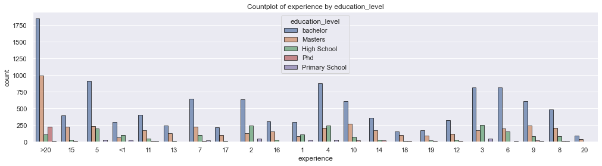
Relationship between experience and education_level

Slide 9
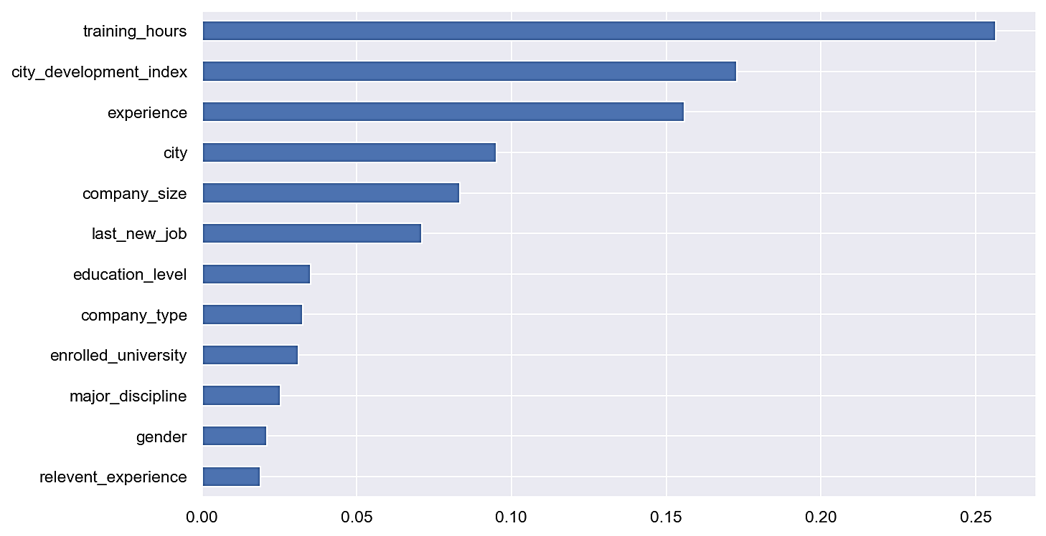
Feature Importance

Slide 10

Modeling
Resampling Methods
Models Used
Results on resampled data

Slide 11
Resampling Methods
Resampling
Oversample
Undersample
SMOTE
NearMiss
SMOTENC
Random Undersampler
ADASYN
SVMSMOTE
Random
Oversampler
BorderlineSMOTE
Combine
SMOTEENN

Slide 12
Models Used
KNN
Logistic Regression
Decision Tree
LightGBM
SVM
XGBoost
Random Forest
CatBoost

Slide 13
Results on resampled dataset
Model | Class | Precision | Recall | F1-score | Macro Avg (Recall)
KNN (k = 19) | 0 | 0.87 | 0.66 | 0.75 | 0.68
 | 1 | 0.42 | 0.71 | 0.53
LightGBM | 0 | 0.89 | 0.76 | 0.82 | 0.75
 | 1 | 0.51 | 0.74 | 0.60
SVM | 0 | 0.86 | 0.76 | 0.80 | 0.70
 | 1 | 0.48 | 0.65 | 0.55
Logistic Regression | 0 | 0.86 | 0.73 | 0.79 | 0.69
 | 1 | 0.46 | 0.65 | 0.54
Decision Tree | 0 | 0.87 | 0.74 | 0.80 | 0.71
 | 1 | 0.47 | 0.68 | 0.56

Slide 14
Hyperparameters tuning result for LightGBM
Hyperparameter | Value
scale_pos_weight | 11
objective | binary
num_leaves | 19
n_estimators | 79
boosting_type | dart

Slide 15







Tools
Seaborn
Numpy
Plotly
Pandas
Jupyter notebook
Scikit Learn
Google Colab

Slide 16

Conclusion
Random Oversampler was the best resampling method
LightGBM was the best model
Grid search and randomized search gave a decent boost
All data features were used to reach to the best accuracy

Slide 17
Thank you
Questions?

